Slide 1
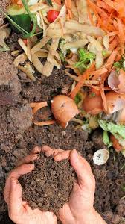

Composting for the Garden
Tuesday, April 5, 2022
6:30 p.m.
Satanta Community Building
108 W. Pawnee, Satanta, KS
Sponsored by the:
Dudley Township Public Library
Topics:
The Composting Process
Compost Bin Design Options
Ingredients for Good Compost
Quick Composting
How to Use Your Product
Troubleshooting Composting Problems
Presenter:
Ron Honig, Extension Agent
KSU Wild West District
Please RSVP if possible
to the DTP Library at 620-649-2213.
Walk-ins welcome.
Come join us as we discuss how to make our own compost this summer.
Kansas State University is committed to making its services, activities and programs accessible to all participants. If you have special requirements due to a physical, vision, or hearing disability, contact Ron Honig, 620-544-4359.
Kansas State University Agricultural Experiment Station and Cooperative Extension Service
K-State Research and Extension is an equal opportunity provider and employer.

