Slide 2
Pie making 101
Nancy Honig Wild West District FCS Agent

Slide 3
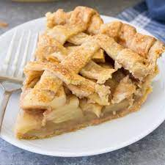
Characteristics of a Good Pie Crust
Flaky
Surface has a rough, blistered appearance rather than a smooth, firm one
Tender, easily cut with a fork, but not so tender it crumbles
Golden-brown color
Flavor is pleasing and delicate and adds to the palatability of the filling.

Slide 4
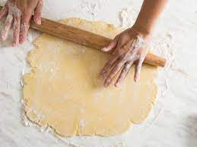
Prevent Gluten
Use as little mixing and handling as possible.
Mix flour with fat before water is added.
Don’t roll multiple times

Slide 5
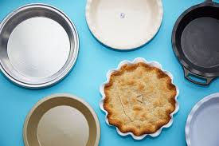
What You Need
Pie Pan
*Ceramic
*Glass
*Metal
*Aluminum
Pastry Blender, fork
Rolling pin
Wax or parchment paper

Slide 6
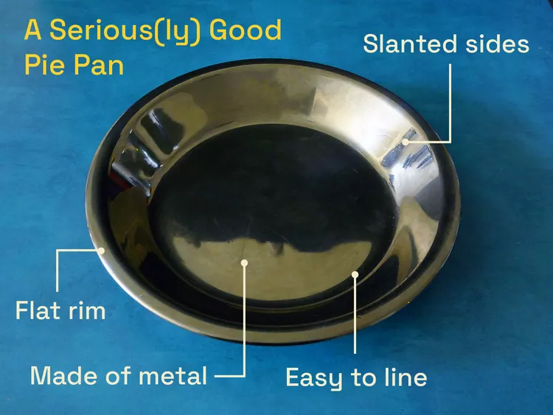
Selecting a Pan
Diameter
Depth
Material
Ceramic
Glass
Metal
Aluminum

Slide 7
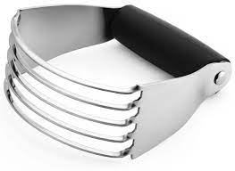
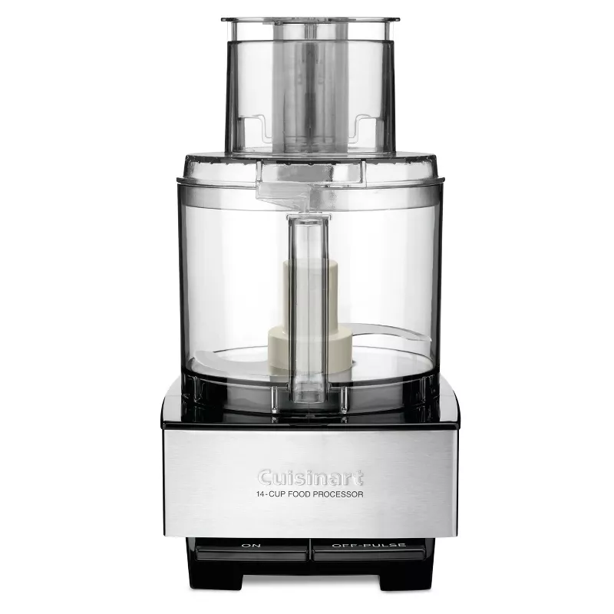
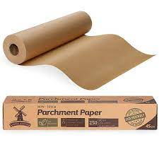
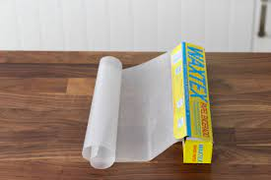
Other Equipment
Pastry Blender Fork Food Processor
Parchment paper, or wax paper

Slide 8
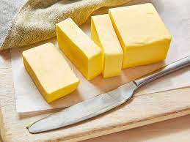
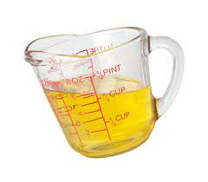
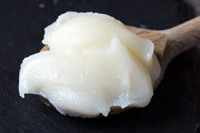
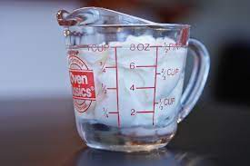
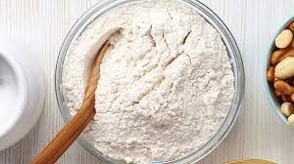
Ingredients
Flour
Fat
Liquid

Slide 9
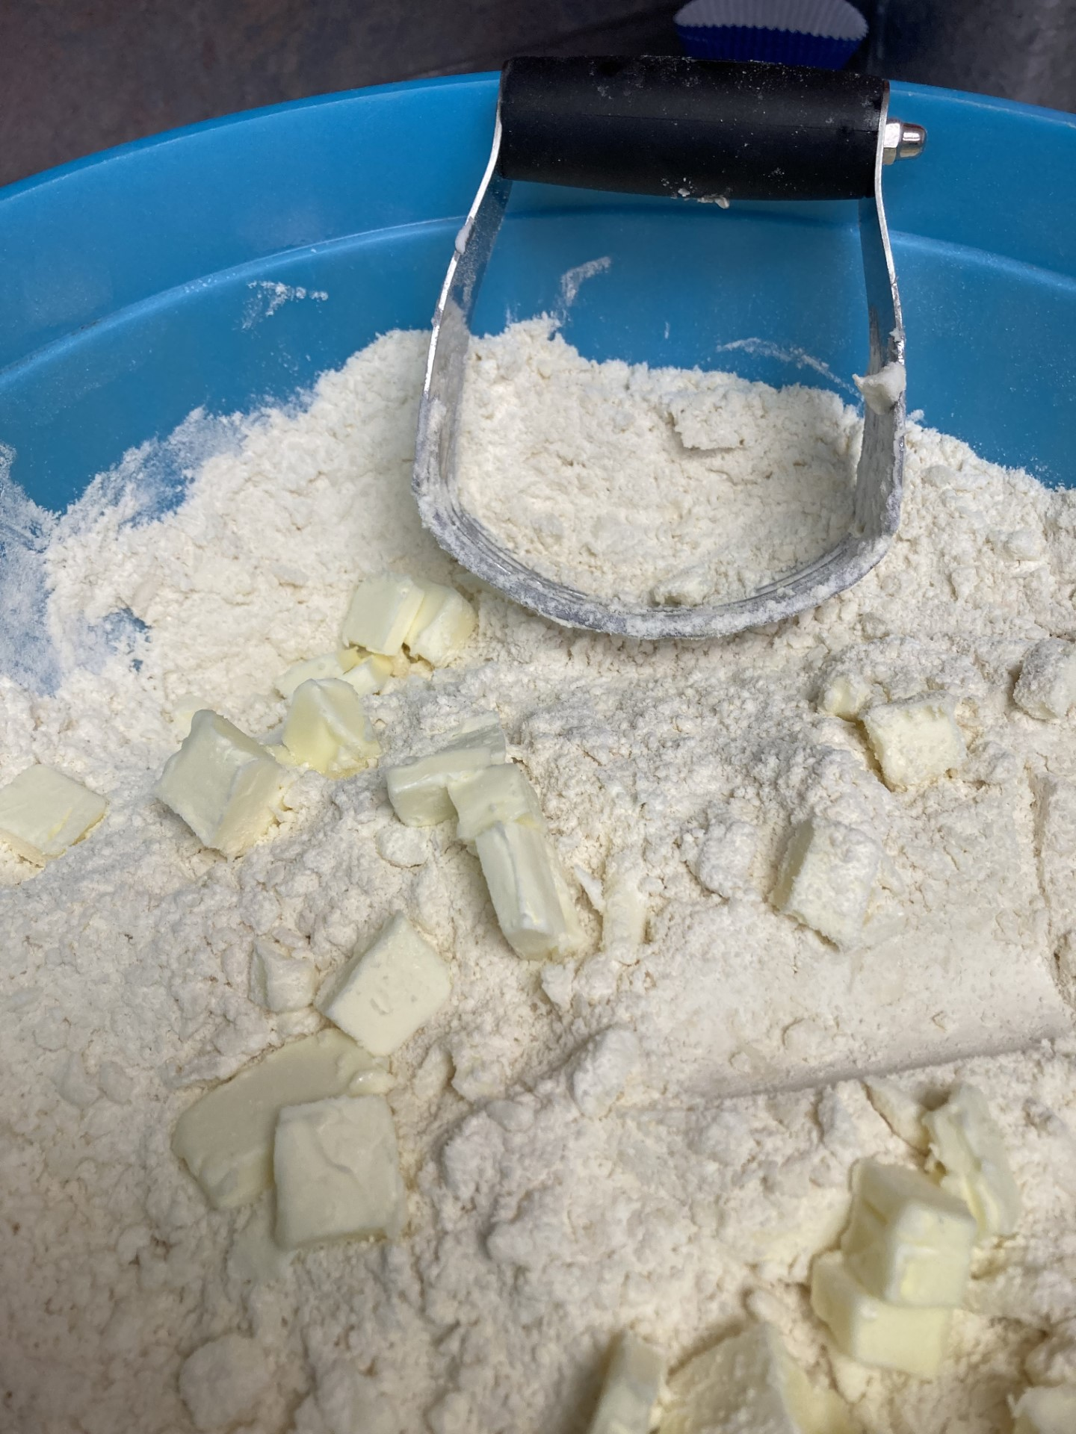
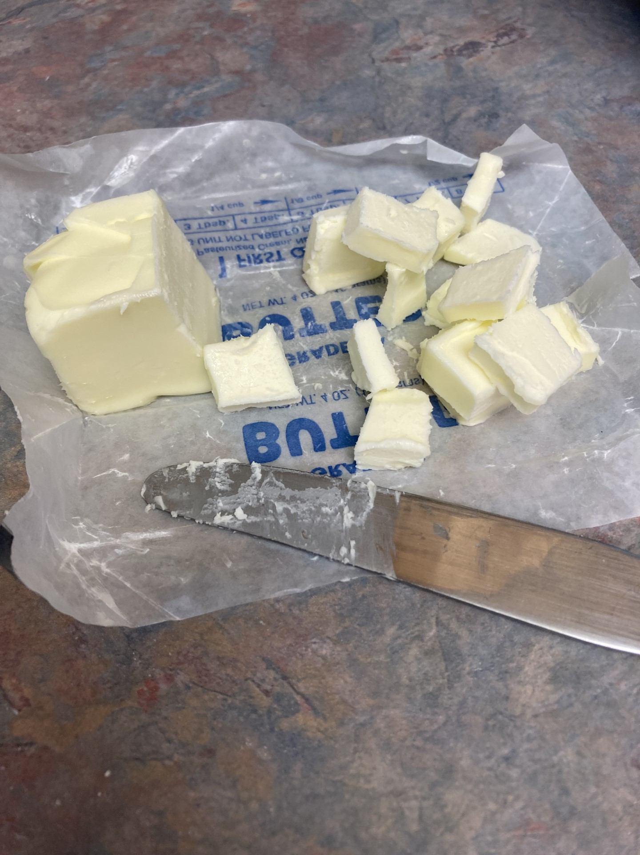
Cut in shortening then cut butter into small chunks and cut in

Slide 10
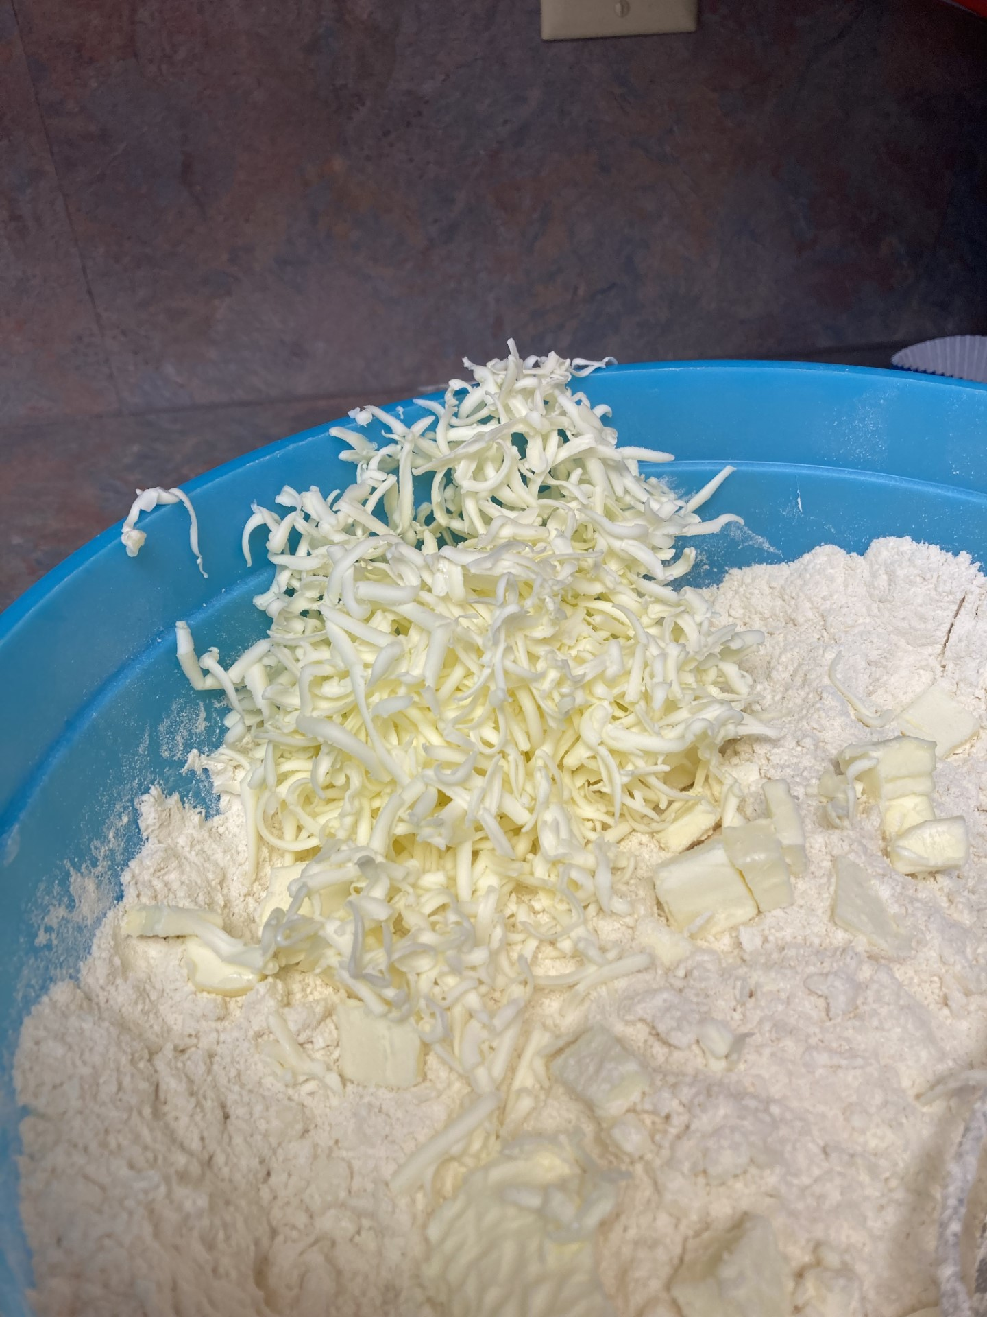
Another option is to grate butter

Slide 11
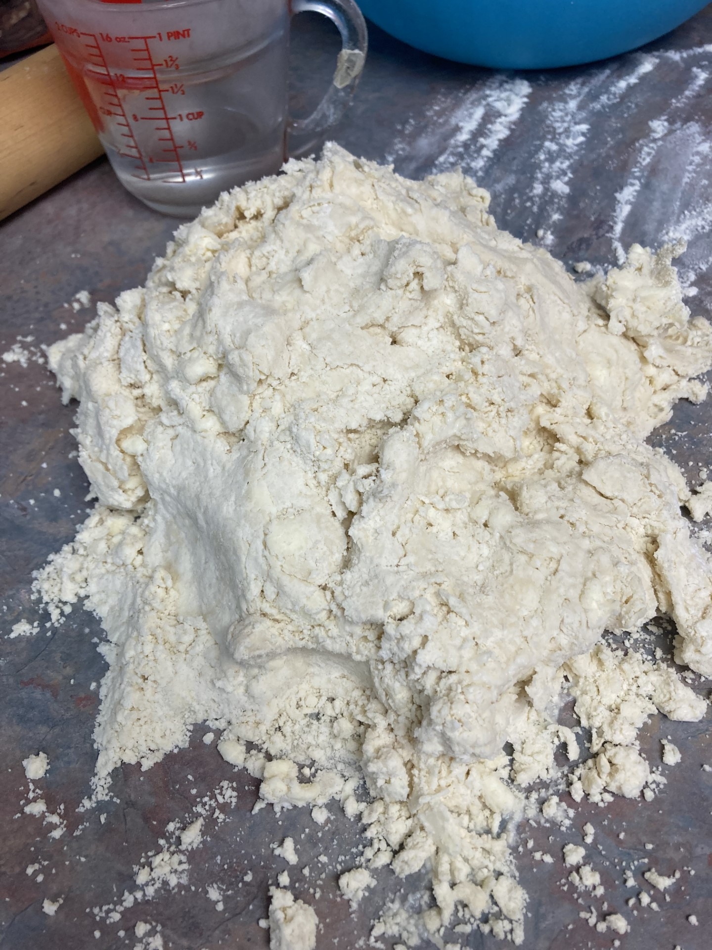
Add water, let sit a minute and gather into a ball, adding more water if needed

Slide 12
Break for Hands on activity

Slide 13
Shape into disc, cover and place in refrigerator

Slide 14
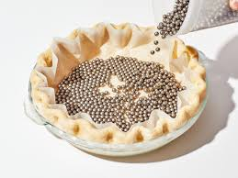
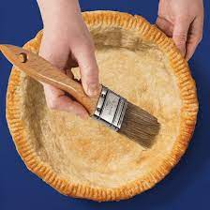
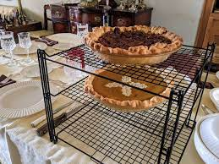
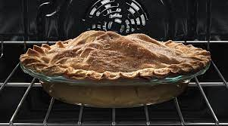
Soggy Bottoms……..
Keep Moisture out
Partially blind bake
Crust Dust
Bake in bottom of oven
Create opening
Pre-heat oven
Cool on wire racks

Slide 15
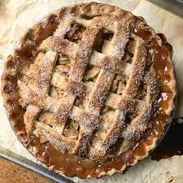
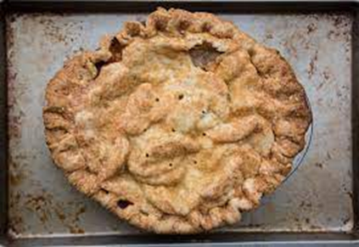
OTHER TIPS
*Sugar
*Nuts
*Cocoa
To prevent shrinkage……..
To prevent leakage……...
To prevent tough crust…….

Slide 16
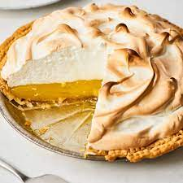
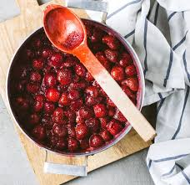
TIPS
Use flour, cornstarch, or tapioca
Macerate and drain
Pre-cook fruit
Too flat……
Too tough…..
Weeps……
Shrinks…..

Slide 17
Place disc on lightly floured surface and begin to roll (think round!)
Remember to pick it up, and flip over multiple times, adding a little flour if needed

Slide 18
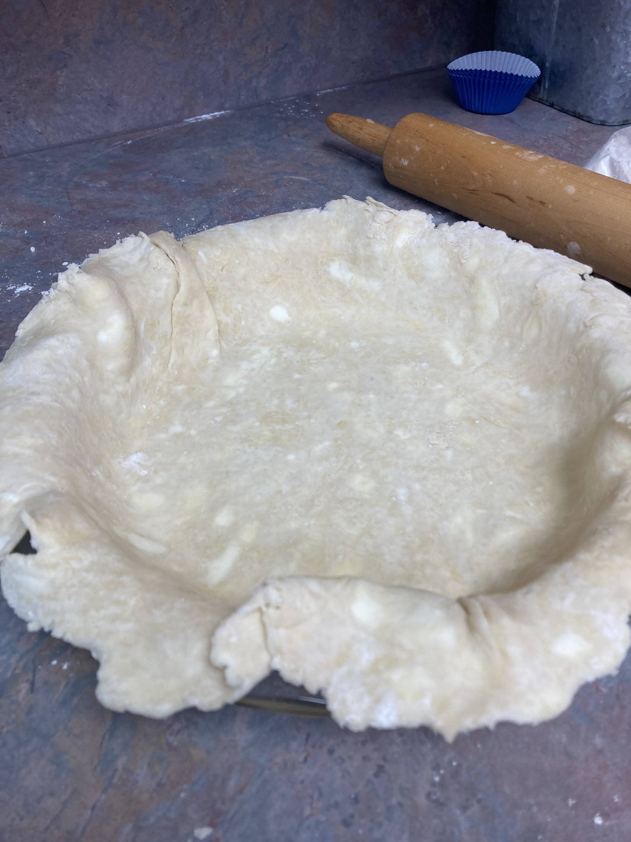
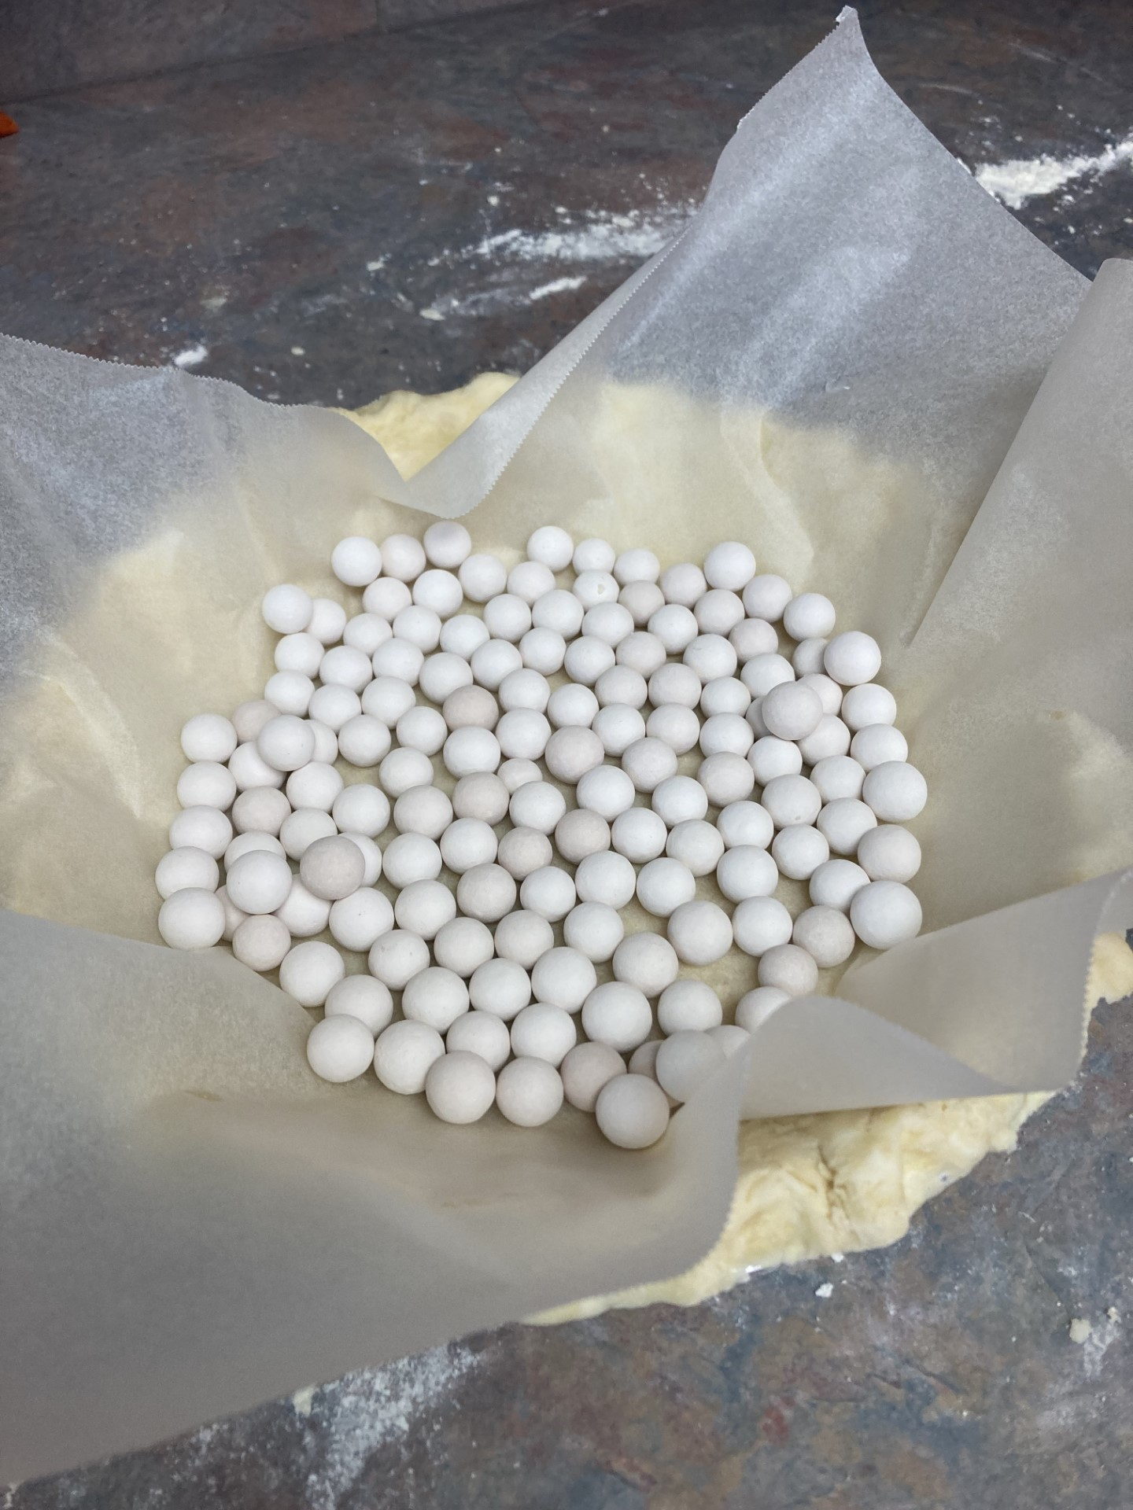
Fold in half, lay in pan, open and crimp edges

Slide 19
Thank You for Attending

